Slide 1
Investigating the Relationships between Air Pollutants and Meteorological Parameters using TEMPO Hourly Data over Highly Polluted Cities in North America
Md Masudur Rahman, Shuo Wang and Weixiong Zhao

Slide 2
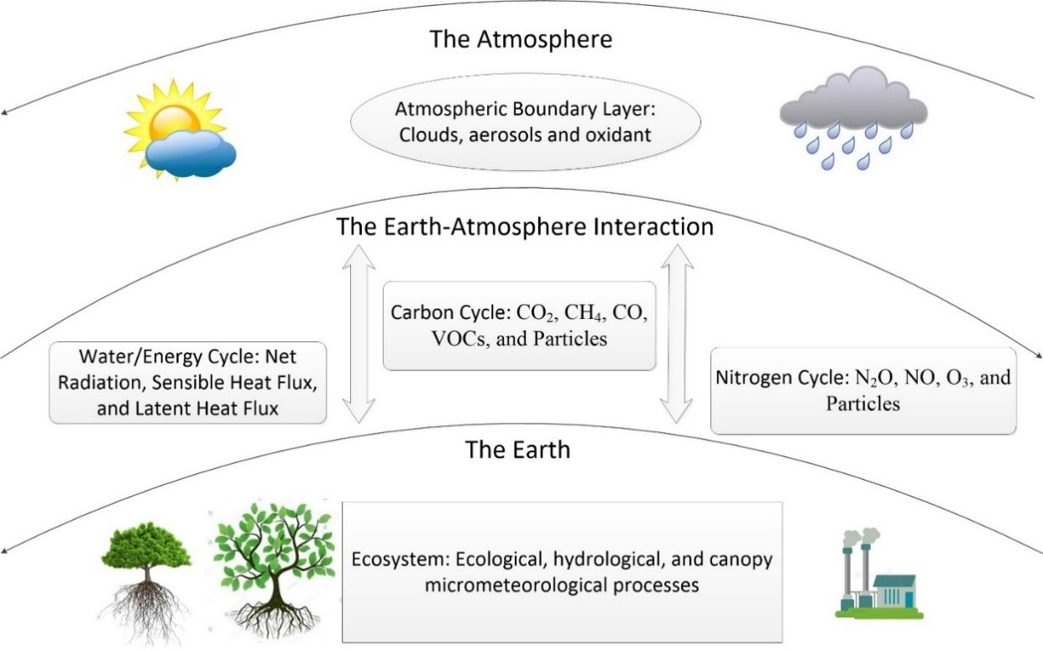
Background
Earth Atmosphere Interaction
Air Pollutants
Health Issues
Meteorological Parameters
Measurement Techniques
Applications

Slide 3
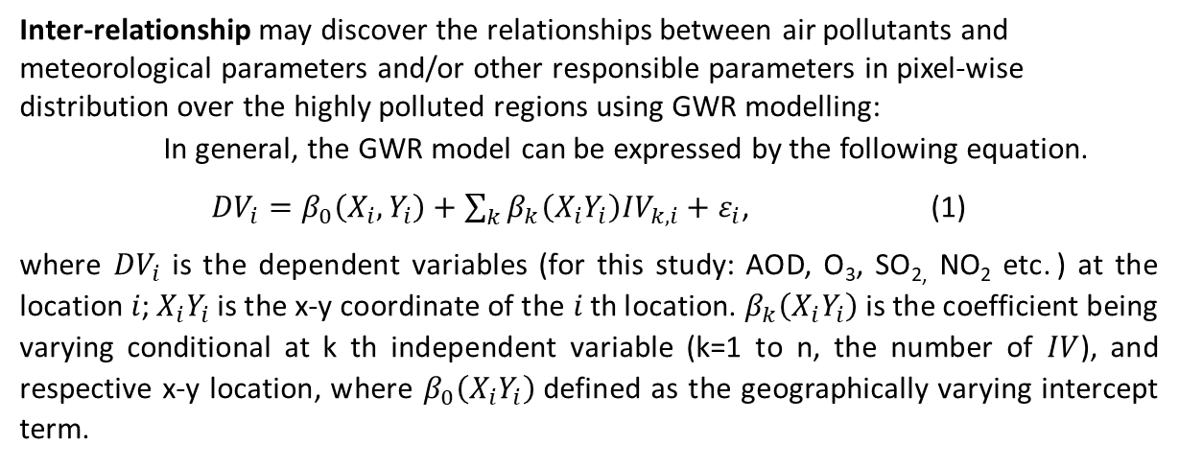
Proposed Experiment
Modelling the Relationships
Inter-relationships
Intra-relationships
Modelling Technique
Geographical Weighted Regression (GWR)
Study Regions
Highly polluted cities in North America such as Bakersfield, Visalia, Los Angeles, Fairbanks etc.
TEMPO Data Specification
Hourly data from TEMPO
Level 2 and Level 3: NO_{2,} SO₂, O₃, and Aerosol
Full year
Inter-relationship may discover the relationships between air pollutants and meteorological parameters and/or other responsible parameters in pixel-wise distribution over the highly polluted regions using GWR modelling:
In general, the GWR model can be expressed by the following equation.
${DV}_{i}=β_{0}\left(X_{i},Y_{i}\right)+\sum_{k}{β_{k}\left(X_{i}Y_{i}\right){IV}_{k,i}+ε_{i}}$, (1)
where ${DV}_{i}$ is the dependent variables (for this study: AOD, O₃, SO_{2,} NO₂ etc. ) at the location 𝑖; $X_{i}Y_{i}$ is the x-y coordinate of the 𝑖 th location. $β_{k}\left(X_{i}Y_{i}\right)$ is the coefficient being varying conditional at k th independent variable (k=1 to n, the number of $IV$), and respective x-y location, where $β_{0}\left(X_{i}Y_{i}\right)$defined as the geographically varying intercept term.
Intra-relationship may investigate the relationship within the gaseous air pollutants and volatile organic compounds (VOCs) using the mathematical ratios and chemical relationships such as:
The ratio of the columnar formaldehyde (HCHO) to nitrogen dioxide (NO₂) that is FNR (HCHO/ NO₂)can be utilized to observe the chemical sensitivity of ozone (O₃) production.
The photochemically converted nitrate and sulfate aerosols may define the relationship between SO_{2,} NO₂ and aerosol i.e AOD

Slide 4
Expected Outcomes of the Experiment
Exploring the methodical investigations of the concern relationships
Spatial and highest temporal (hourly i.e. diurnal) representation of the coefficients
The FNR at highest temporal resolution to achieve more efficient chemical sensitivity of O₃ formation in the Earth’s surface
The hourly i.e. diurnal estimation of the photochemically converted nitrate and sulfate aerosols will provide more meaningful relationship within SO_{2,} NO₂ and aerosol (AOD)

Slide 5
Questions and Answers
THANK YOU
ASSALAMUALYKUM
DHONNOBAD
XIEXIE
THANK YOU
ASSALAMUALYKUM
DHONNOBAD
XIEXIE

